Slide 1

Review and Practice of the
Woodcock Johnson IV
Brenda DE LA GARZA
Education specialist
Special education program
School improvement, accountability and compliance
Region one
bdelagarza@esc1.net

Slide 2
Objectives
Gain understanding of the changes on the WJ IV
Overview of the new tests

Slide 3
Cognitive: What’s New?
NEW!
Emphasis on core set of tests (1–7)
Gf-Gc composite
6 new or modified tests: Nonword Repetition, Phonological Processing, Letter-Pattern Matching, Verbal Attention, Visualization, and Oral Vocabulary
New clusters focusing on important narrow abilities, including perceptual speed, number facility, quantitative reasoning, auditory memory span, vocabulary, and cognitive efficiency

Slide 4

Core Tests
Cog: Tests 1-7
OL: Test 1-4
ACH: Test 1-6

Slide 5


Slide 6
Comprehension-Knowledge (Gc) Cluster Composition
WJ IV Gc Cluster
Test 1: Oral Vocabulary
(2 subtests: Synonyms and Antonyms)
Test 8: General Information
WJ III Gc Cluster
Test 1: Verbal Comprehension
(4 subtests: Picture Vocabulary, Synonyms,
Antonyms, Verbal Analogies)
Test 11: General Information
Notes:
NOTES:
General Information is in both clusters. The Oral Vocabulary test in the WJ IV cluster is part of the Verbal Comprehension test in the WJ III cluster. Now just Synonyms and Antonyms are in the test whereas there were 4 subtests in Verbal Comp in the WJ III (Picture Vocabulary, Synonyms, Antonyms, and Verbal Analogies)

Slide 7
Fluid Reasoning (Gf) Cluster Composition
WJ IV Gf Cluster
Test 2: Number Series
Test 9: Concept Formation
WJ III Gf Cluster
Test 5: Concept Formation
Test 15: Analysis-Synthesis
Notes:
NOTES:
Concept Formation is in both clusters, but the second test is new. Number Series in the WJ IV cluster replaces Analysis-Synthesis.

Slide 8
Short-Term Working Memory (Gwm) Cluster Composition
WJ IV Gwm Cluster
Test 3: Verbal Attention
Test 10: Numbers Reversed
WJ III Gsm Cluster
Test 7: Numbers Reversed
Test 17: Memory for Words
Notes:
NOTES:
Numbers Reversed is in both clusters, however the basal/ceiling rules have changed (no longer within a group of items of the same length). The second test (Verbal Attention) is new and more a working memory measure. Memory for Words in the WJ III cluster was a memory span measure.

Slide 9
Cognitive Processing Speed (Gs) Cluster Composition
WJ IV Gs Cluster
Test 4: Letter-Pattern Matching
Test 17: Pair Cancellation
WJ III Gs Cluster
Test 6: Visual Matching (Number-Pattern Matching)
Test 16: Decision Speed (dropped)
Notes:
NOTES:
Both tests are different in the WJ IV cluster.

Slide 10
Auditory Processing (Ga) Cluster Composition
WJ IV Ga Cluster
Test 5: Phonological Processing
Test 12: Nonword Repetition
WJ III Ga Cluster
Test 4: Sound Blending (moved to OL)
Test 14: Auditory Attention (dropped)
Notes:
NOTES:
The Ga clusters are quite different. WJ IV Ga cluster is composed of 2 new tests. The cognitive complexity of these tests is much higher than the tests in the WJ III Ga cluster. There is a higher g-loading now due to this increased complexity.

Slide 11
Long-Term Retrieval (Glr) Cluster Composition
WJ IV Glr Cluster
Test 6: Story Recall
Test 13: Visual-Auditory Learning
WJ III Glr Cluster
Test 2: Visual-Auditory Learning
Test 12: Retrieval Fluency (moved to OL)
Notes:
Notes:
VAL is the same in both clusters. Second test is different.

Slide 12
Visual Processing (Gv) Cluster Composition
WJ IV Gv Cluster
Test 7: Visualization
Test 14: Picture Recognition
WJ III Gv Cluster
Test 3: Spatial Relations (subtest in Visualization)
Test 13: Picture Recognition
Notes:
NOTES:
One of the clusters that has changed the least. Includes the same measures, but WJ IV has added the subtest Block Rotation to combine with Spatial Relations to form the Visualization test. Picture Recognition is essentially the same, but scoring is now 1 or 0, no multiple points or partial credit allowed

Slide 13
Cognitive Standard Battery
(Tests 1–10)
Test 1: Oral Vocabulary (Gc)
Test 2: Number Series (Gf)
Test 3: Verbal Attention (Gwm)
Test 4: Letter-Pattern Matching (Gs)
Test 5: Phonological Processing (Ga)
Test 6: Story Recall (Glr)
Test 7: Visualization (Gv)
Test 8: General Information (Gc)
Test 9: Concept Formation (Gf)
Test 10: Numbers Reversed (Gwm)
GIA
Core Tests
Required for Intra-Cog Variation
Notes:
NOTES:
The first 7 tests create the GIA score, serve as the core COG battery, and are required for calcuating the intracognitive variation. (Also get the BIA from Tests 1, 2, and 3 and the Cognitive Efficiency-Std cluster from Tests 3 and 4)
If administering Tests 8-10, you obtain 3 CHC broad ability clusters (Gc, Gf, Gwm).

Slide 14
General Intellectual Ability Options
General Intellectual Ability (GIA)
Tests 1–7 (35–40 minutes)
Median reliability: .97
Brief Intellectual Ability (BIA)
Tests 1–3 (10–15 minutes)
Median reliability: .94
Gf-Gc Composite
Tests 1, 2, 8, & 9 (15–20 minutes)
Median reliability: .95
Notes:
NOTES:
Median reliability across all technical age groups (see TM)

Slide 15

Comprehension-Knowledge (Gc)
Test 1: Oral Vocabulary
Test 8: General Information (was in WJ III)
Other Gc tests
OL Test 1: Picture Vocabulary
Important for academic success, across domains and ages
Strong g loading: .74
Notes:
NOTES:
WJ IV cluster is “similar” to WJ III Gc cluster. One of the 2 clusters that has changed the least.
Oral Vocabulary (2 subtests) has changed from Verbal Comprehension (4 subtests)
General Information is the same

Slide 16
Test 1: Oral Vocabulary
1A Synonyms, 1B Antonyms
Both subtests must be administered.
Basal/Ceiling rules apply to each subtest: (test by complete pages)
  6 lowest correct or Item 1
  6 highest incorrect or last item
Expanded correct and incorrect keys
Test modified from WJ III COG (Verbal Comprehension): 2 subtests instead of 4
VIDEO
Notes:
NOTES:
Remind examiners to query for “one-word” when a two or more word response is given. Stated in overview section, not on individual test pages.
Also, on antonyms – query for “another word” when response is stimulus with “un” or ‘non” in front (except if listed in key).

Slide 17
Test 1A: Oral Vocabulary–Synonyms
Gc-VL (Lexical Knowledge)

Slide 18
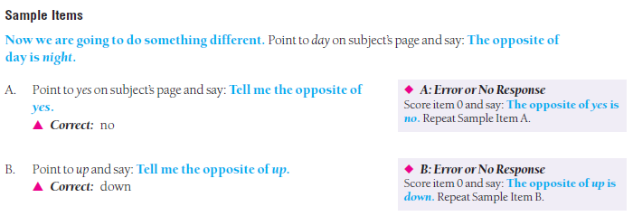
Test 1B: Oral Vocabulary–Antonyms
Gc-VL (Lexical Knowledge)

Slide 19

Fluid Reasoning (Gf)
Test 2: Number Series
Test 9: Concept Formation (was in WJ III)
Other Gf tests
Test 15: Analysis-Synthesis (was in WJ III)
Important for academic success, especially applying skills
Strong g loading: .78
Notes:
NOTES:
Gf cluster has changed:
WJ IV: Number Series is new to cluster, Concept Formation was in WJ III Gf clusters
WJ III: Concept Formation and Analysis-Synthesis

Slide 20
Test 2: Number Series
Basal/Ceiling rules:
  5 lowest correct or Item 1
  5 highest incorrect or last item
Provide worksheet and pencil when directed.
Monitor response time (1 minute per item).
Number Series was in the WJ III COG DS.
Gf-RQ (Quantitative Reasoning)
Gf-I (Inductive Reasoning)
VIDEO

Slide 21
Test 2: Number Series

Slide 22
Test 2: Number Series
You can cover additional problems with your hand or a paper if more than one item per page confuses the examinee.

Slide 23
Test 9: Concept Formation
Creates Gf cluster when combined with Test 2: Number Series
Starting Point: Introduction 1 or 2
Cutoffs determine when to discontinue testing.
Controlled learning task
Concept Formation was in WJ III COG.
Gf-I (Inductive Reasoning)

Slide 24

Short-Term Working Memory (Gwm)
Test 3: Verbal Attention
Test 10: Numbers Reversed
Other Gwm tests
Test 16: Object-Number Sequencing
Test 18: Memory for Words
OL Test 5: Sentence Repetition
Important for academic success across domains and ages
Strong g loading: .76
Notes:
NOTES:
WJ IV Gwm cluster has changed from WJ III Gsm cluster.
WJ IV: Verbal Attention is new, Numbers Reversed was in WJ III cluster, but basal/ceiling rules have changed
WJ III Gsm cluster: Numbers Reversed and Memory for Words

Slide 25

Test 3: Verbal Attention
NEW!
New test
Use audio recording.
Do not repeat any items during test.
Starting point: Sample Item A or Sample Item C
  Sample Item A start: If 2 or fewer correct on Items 1–8, discontinue testing
  Sample Item C start or continuing from Item 8:
    Basal: 6 lowest correct or Item 1
    Ceiling: 6 highest incorrect or last item
VIDEO & Activity

Slide 26
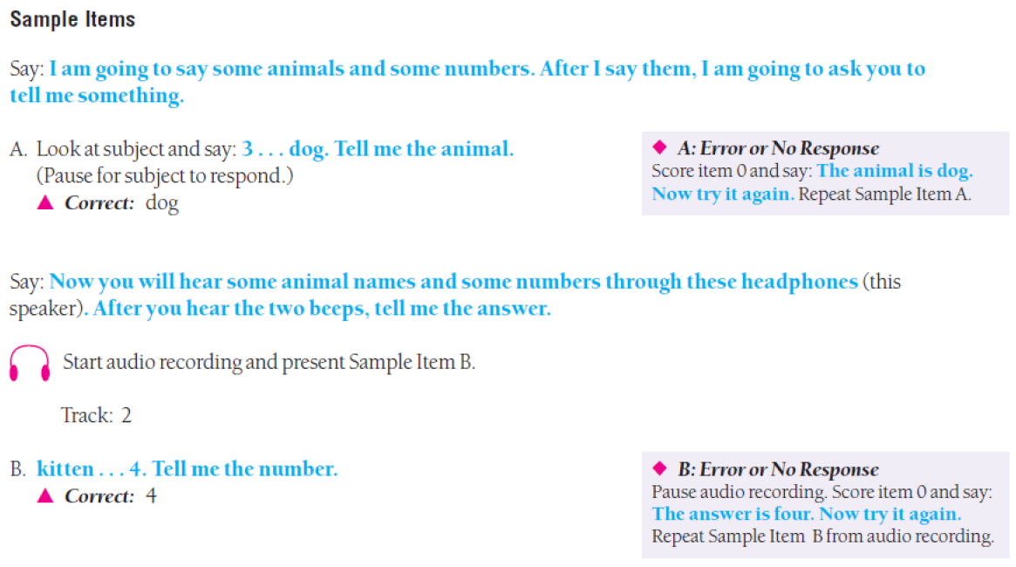
Test 3: Verbal Attention

Slide 27
Test 10: Numbers Reversed
Creates Gwm cluster when combined with Test 3: Verbal Attention
Use audio recording.
Use suggested starting points.
Basal: 5 lowest correct or Item 1
Ceiling: 5 highest incorrect or last item
Modified from WJ III COG (change in basal/ceiling rules—no longer by group)
Gwm-WM (Working Memory)

Slide 28
Test 16: Object-Number Sequencing
Creates Gwm–Extended cluster when combined with Test 3: Verbal Attention and Test 10: Number Reversed
Use audio recording.
After Sample Item A, use suggested starting points.
Basal: 5 lowest correct or Item 1
Ceiling: 5 highest incorrect or last item
Modified from WJ III COG (Auditory Working Memory); scoring changed to 1 or 0
Gwm-WM (Working Memory)

Slide 29
Test 18: Memory for Words
Creates Auditory Memory Span cluster when combined with OL Test 5: Sentence Repetition
Use audio recording.
After Sample Items A and B, use suggested starting points.
Basal: 4 lowest correct or Item 1
Ceiling: 4 highest incorrect or last item
Modified from WJ III COG (change in Basal/Ceiling rules—no longer by group)
Gwm-MS (Memory Span)

Slide 30
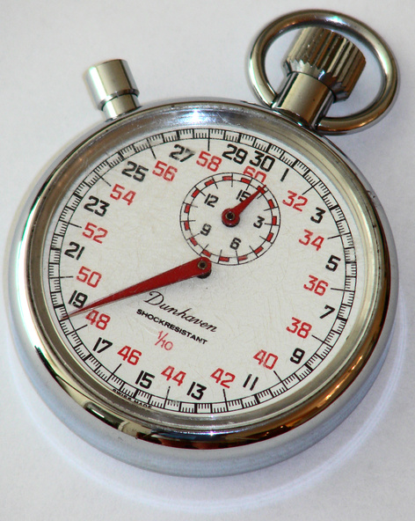
Cognitive Processing Speed (Gs)
Test 4: Letter-Pattern Matching
Test 17: Pair Cancellation (was in WJ III)
Other Gs tests
Test 11: Number-Pattern Matching
(as Visual Matching in WJ III COG)
Important for academic success, especially during skill acquisition
Moderate g loading: .62
Notes:
NOTES:
WJ IV Gs cluster has changed from WJ III Gs cluster
WJ IV Gs clusters: includes new test Letter-Pattern Matching and Pair Cancellation (was in WJ III)
WJ III Gs cluster includes Visual Matching (now named Number-Pattern Matching) & Decision Speed (dropped)

Slide 31


Test 4: Letter-Pattern Matching
NEW!
New test
Timed test: 3 minutes
Use Response Booklet.
Begin with Sample Item A and Practice Exercise.
Measures important Gs ability, perceptual speed
Provides a measure of orthographic processing
VIDEO & Activity
Gs-P (Perceptual Speed)

Slide 32
Test 4: Letter-Pattern Matching
Gs-P (Perceptual Speed)

Slide 33
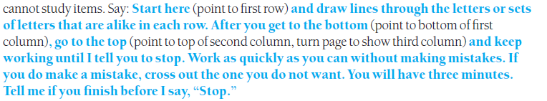
Test 4: Letter-Pattern Matching
Open the Response Booklet to Letter-Pattern Matching test items and hold up booklet so subject
Hold the Response Booklet up and point as directed.
Do not lay the Response Booklet in front of the examinee while giving the directions.

Slide 34

Auditory Processing (Ga)
Test 5: Phonological Processing
Test 12: Nonword Repetition
Other Ga tests
OL Test 3: Segmentation
OL Test 7: Sound Blending
Important for academic success, especially during skill acquisition
Strong g loading: .77
Notes:
NOTES:
WJ IV Ga cluster is different from WJ III Ga cluster. Most changed cluster.
WJ IV Ga: includes 2 new tests, Phonological Processing and Nonword Repetition
WJ III Ga: included Sound Blending (now in OL) and Auditory Attention (dropped)

Slide 35
Auditory Processing (Ga)
Increased cognitive complexity in the WJ IV Ga cluster
Very different from WJ III Ga cluster
Two new tests measuring multiple abilities
  Word fluency, speed of lexical access, phonological storage, phonetic coding, working memory
  Strong g loading: (.77)

Slide 36
NEW!
Test 5: Phonological Processing
New test
Measures 3 aspects of speech sound processing that lead to the construction of sound-based lexical representations
3 subtests: Word Access, Word Fluency, and Substitution
Administer all 3 subtests to obtain a score.
Ga-PC (Phonetic Coding)
Glr-LA (Speed of Lexical Access)
Gs-FW (Word Fluency)

Slide 37
Test 5A: Phonological Processing–Word Access
Use audio recording for Items 4 and higher.
Select appropriate starting point
  Sample Item A: Preschool–Kindergarten
  Sample Item C: Grade 1–Adult
Responses must be real words in English to receive credit.
Ask for a one-word response if examinee gives two or more words.

Slide 38
Test 5A: Phonological Processing–Word Access
Starting point for Preschool to K
If 0 correct on Items 1–3, discontinue testing

Slide 39
Test 5A: Phonological Processing–Word Access
Starting point for Grade 1 and higher
C. Tell me a word that starts with the /b/ sound. /b/.
Basal: 6 lowest correct or Item 1
Ceiling: 6 highest incorrect or last item

Slide 40
Test 5B: Phonological Processing–Word Fluency
Administer both items to all examinees.
  Item 1: words that begin with /m/ sound as in milk
  Item 2: words that begin with /d/ sound as in dog
Use tally marks to record correct responses.
  Do not accept duplicate responses.
  Do not accept the example word as correct.
Time limit: 1 minute for each item

Slide 41
Test 5C: Phonological Processing–Substitution
Use audio recording for Sample Items C and D and Items 3 and higher.
Basal/Ceiling rules:
  6 lowest correct or Item 1
  6 highest incorrect or last item
If examinee has no correct responses on Sample Items A and B, discontinue testing.

Slide 42
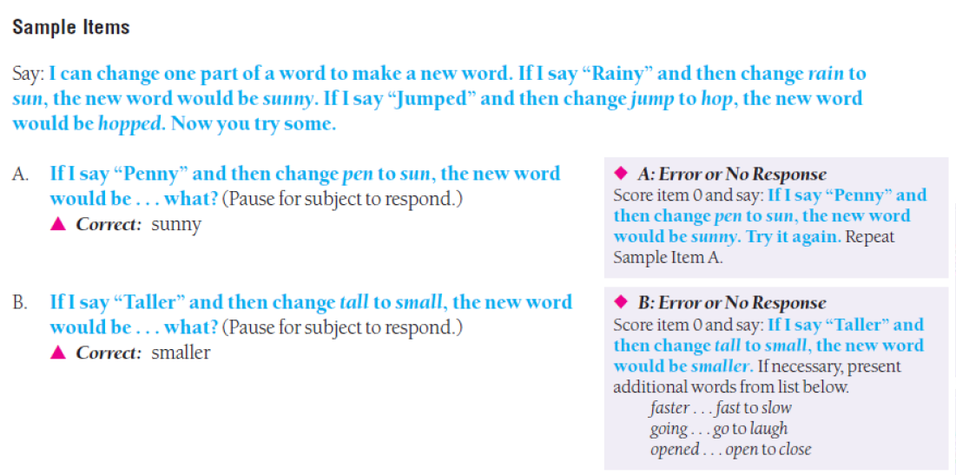
Test 5C: Phonological Processing–Substitution

Slide 43
Test 12: Nonword Repetition
NEW!
New test measuring phonological short-term memory
Creates Ga cluster when combined with Test 5: Phonological Processing
Use audio recording.
Do not repeat any items during test.
Basal: 6 lowest correct or Item 1
Ceiling: 6 highest incorrect or last item
Begin with sample items for all examinees, then select appropriate starting point.
Ga-UM (Memory for Sound Patterns)

Slide 44
Test 12: Nonword Repetition
Ga-UM (Memory for Sound Patterns)
Narrow ability definition expanded to include phonological storage ability or short-term memory for speech sounds.
Related constructs include phonological short-term memory and echoic memory.

Slide 45
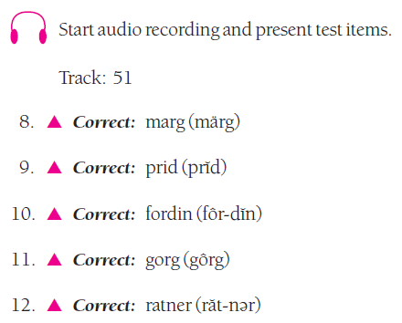
Test 12: Nonword Repetition
Use audio recording beginning with Item 8.
Responses must be pronounced smoothly as a
whole word to receive credit.

Slide 46
Test 12: Nonword Repetition
Audio recording ensures each examinee hears the same stimulus.
Listen carefully to the stimulus and response to facilitate scoring.

Slide 47

Long-Term Retrieval (Glr)
Test 6: Story Recall
Test 13: Visual-Auditory Learning
Important for academic success, especially in skill acquisition
Strong g loading: .72
Notes:
NOTES:
WJ IV Glr cluster is different from WJ III Glr cluster.
WJ IV Glr: includes Story Recall (moved from ACH), and VAL (was in WJ III cluster)
WJ III Glr: Included VAL and Retrieval Fluency (now in OL)

Slide 48
Test 6: Story Recall
Use audio recording.
Select appropriate starting point.
Follow Continuation Instructions to determine when to give additional stories or when to discontinue testing.
Scoring of recalled elements is based on a key word in each element.
Story Recall moved from WJ III ACH to WJ IV COG.
Glr-MM (Meaningful Memory)

Slide 49

Visual Processing (Gv)
Test 7: Visualization(spatial relations)
Test 14: Picture Recognition
Important to math success
Moderate g loading: .68
Notes:
NOTES:
WJ IV Gv cluster has changed from WJ III Gv cluster. This is the cluster that has changed the least.
WJ IV Gv cluster: includes new combined test Visualization (includes Spatial Relations & Block Rotation) and Picture Recognition
WJ III Gv cluster: Includes Spatial Relations (now a subtest of Visualization) and Picture Recognition

Slide 50
Test 7: Visualization
7A Spatial Relations, 7B Block Rotation
NEW!
New test
Both subtests must be administered.
Basal/Ceiling rules apply to each subtest.
Modified from WJ III COG (Spatial Relations) and WJ III COG DS (Block Rotation)
Gv-Vz (Visualization)

Slide 51
Test 7B: Visualization–
Block Rotation
Select appropriate starting point.
  Preschool to Grade 6: Introduction 1
  Grade 7 to Adult: Introduction 3
Ceiling: 5 highest items incorrect or last item
If necessary, use hand or piece of paper to reveal only one item at a time.
Be sure to point as directed.
Position yourself to see examinee side of Test Book to insure accurate pointing.

Slide 52
Test 7B: Visualization–
Block Rotation
Introduction 1: Starting point for Preschool to Grade 6
Both drawings must be correctly identified to be scored as correct (1).

Slide 53
Test 7B: Visualization–
Block Rotation
All items have a 30-second guideline. If examinee is still trying to solve the problem, allow more time.

Slide 54
Test 7B: Visualization–
Block Rotation
Beginning with Item 6, examinees may not touch the page.
Both drawings must be correctly identified to be scored as correct (1).

Slide 55


Slide 56
Oral Language Battery
NEW!
One easel-style Test Book
12 tests (9 English, 3 Spanish)
Core set of tests (1–4)
  Serves as basis for intra-oral language variation procedure
  Measures 4 aspects of oral language
Uses Broad Oral Language as the predictor in an ability/achievement procedure
Provides 3 parallel English and Spanish tests

Slide 57
Oral Language Battery
4 tests relocated from WJ III COG or DS
  Sound Blending, Rapid Picture Naming, Retrieval Fluency, Sentence Repetition
4 tests relocated from the WJ III ACH
  Picture Vocabulary, Oral Comprehension, Understanding Directions, Sound Awareness
1 new test: Segmentation
3 Spanish tests: parallel to Picture Vocabulary, Oral Comprehension, and Understanding Directions

Slide 58
Test 3: Segmentation
NEW!
A measure of phonetic coding, an aspect of Auditory Processing (Ga), that contributes to the Phonetic Coding cluster
Select appropriate starting point.
Basal/Ceiling rules:
  5 lowest correct or Item 1
  5 highest incorrect or last item
Items may be repeated upon request.

Slide 59
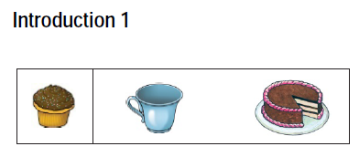
Test 3: Segmentation
Starting point for Preschool to Grade 2
Say: I’m going to break up one word into two words. Point to picture of cupcake and say: The word cupcake has two words in it. If we took it apart, it would be cup (point to picture of cup) and cake (point to picture of cake).

Slide 60
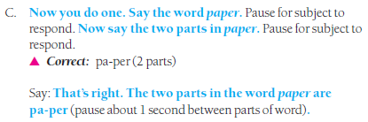
Test 3: Segmentation
Starting point for Grade 3 to Adult
Say: I am going to say a word and then say its parts. The word doctor has two syllables or parts. Listen. Doc…tor.

Slide 61
Test 3: Segmentation
Examiner pronounces the whole word fluently. Do not pause between syllables.
Notes:
Does not pause

Slide 62
Test 3: Segmentation
Items 11–20:
Score any reasonable break between syllables as correct. It must have the same number of parts as shown in the key.
Ma-ster would also be correct.

Slide 63
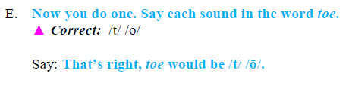
Test 3: Segmentation
(after Item 20)
Say: I am going to say all of the sounds in a word one at a time. For example, the word dime would be /d/ /ī/ /m/. Listen to the sounds in the word play—/p/ /l/ /ā/. Say each sound, pausing briefly between each one.

Slide 64
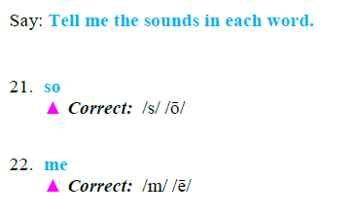
Test 3: Segmentation
Examiner pronounces the whole word fluently.
Examinee must say the individual sounds to receive credit.

Slide 65
Auditory Memory Span
(requires 1 test from WJ IV COG)
Includes 2 tests measuring the narrow short-term working memory ability of auditory memory span
  Test 5: Sentence Repetition (from WJ IV OL)
  Test 18: Memory for Words (from WJ IV COG)
Median reliability: .88 (5–19) .91 (adult)

Slide 66
Test 5: Sentence Repetition
A measure of auditory memory span, an aspect of Short-Term Working Memory (Gwm), that contributes to 2 clusters: Oral Expression, Auditory Memory Span
Use audio recording for Sample Item B and Item 9 and higher.
Select appropriate starting point.
Basal/Ceiling rules:
  4 lowest correct or Item 1
  4 highest incorrect or last item

Slide 67
Test 5: Sentence Repetition
Starting point for Preschool to Grade 1
Do not repeat or replay any items except as directed in Test Book.

Slide 68
Test 5: Sentence Repetition
Score all items 1 or 0. Item must be repeated exactly to receive a 1.
Items are printed in Test Record for easy scoring.

Slide 69
Test 5: Sentence Repetition
a
0
has
0
You can mark errors in the Test Record for qualitative information.
1
Lucy
0
1
1

Slide 70
Test 9: Sound Awareness
9A Rhyming, 9B Deletion
A screening measure of phonological awareness, an aspect of Auditory Processing (Ga)
Use only as a screening measure for K–3 or older examinees with limited phonological awareness.
Administer both subtests: 9A Rhyming and 9B Deletion.
VIDEO

Slide 71
Test 9A: Sound Awareness–Rhyming
Select appropriate starting point.
Words must be real words that rhyme with the target to receive credit.
Early items require pointing to 2 pictures that end alike or rhyme.
Later items require providing a rhyming word.
Ceiling: 6 highest incorrect or last item

Slide 72
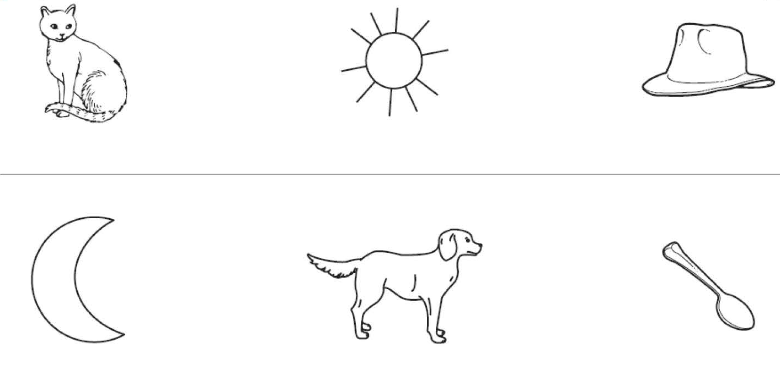
Test 9A: Sound Awareness–Rhyming

Slide 73
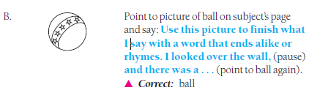
Test 9A: Sound Awareness–Rhyming
Examples of other item types

Slide 74
Test 9B: Sound Awareness–Deletion
All examinees start with Sample Item A.
Use audio recording for Sample Item B and all test items.
Ceiling: 6 highest incorrect or last item

Slide 75



Test 9B: Sound Awareness–Deletion
Items progress from deleting a word from a compound word, to deleting a syllable, to deleting a specific sound.

Slide 76
Administering the Spanish Tests
There are 3 parallel tests in English and Spanish.
Ideally, a proficient bilingual examiner (English and Spanish) should administer the parallel tests.
Use the primary/ancillary examiner team approach if a bilingual examiner is not available.
See Chapter 6 of the WJ IV OL Examiner’s Manual for details on implementing the primary/ancillary examiner team approach.

Slide 77
Oral Expression
Includes 2 tests measuring various aspects of oral expression, including lexical knowledge, language development, and syntactic knowledge
  Test 1: Picture Vocabulary
  Test 5: Sentence Repetition
Median reliability: .88 (5–19) .92 (adult)

Slide 78
Listening Comprehension
Includes 2 tests measuring listening ability, verbal comprehension, and short-term working memory for language
  Test 2: Oral Comprehension
  Test 6: Understanding Directions
Median reliability: .89 (5–19) .90 (adult)
Parallel Spanish cluster is Comprensión auditiva.

Slide 79
Lenguaje oral
Includes 2 tests measuring various aspects of oral language, including lexical knowledge, listening comprehension, and verbal comprehension
  Test 10: Vocabulario sobre dibujos
  Test 11: Comprensión oral
Parallel to the Oral Language cluster

Slide 80
Comprensión auditiva
Includes 2 tests measuring listening ability, verbal comprehension, and short-term working memory for language
  Test 11: Comprensión oral
  Test 12: Comprensión de indicaciones
Parallel to the Listening Comprehension cluster

Slide 81
Comparative Language Index (CLI)
Comparative Language Index
English Cluster | Spanish Cluster
Oral Language Test 1: Picture Vocabulary Test 2: Oral Comprehension | Lenguaje oral Test 10: Vocabulario sobre dibujos Test 11: Comprensión oral
Broad Oral Language Test 1: Picture Vocabulary Test 2: Oral Comprehension Test 6: Understanding Directions | Amplio lenguaje oral Test 10: Vocabulario sobre dibujos Test 11: Comprensión oral Test 12: Comprensión de indicaciones
Listening Comprehension Test 2: Oral Comprehension Test 6: Understanding Directions | Comprensión auditiva Test 11: Comprensión oral Test 12: Comprensión de indicaciones

Slide 82
Comparative Language Index (CLI)
Spanish oral language proficiency
RPI = 66/90
English oral language proficiency
RPI = 15/90
S/E CLI = 66/15
Comparative Language Index

Slide 83


Slide 84
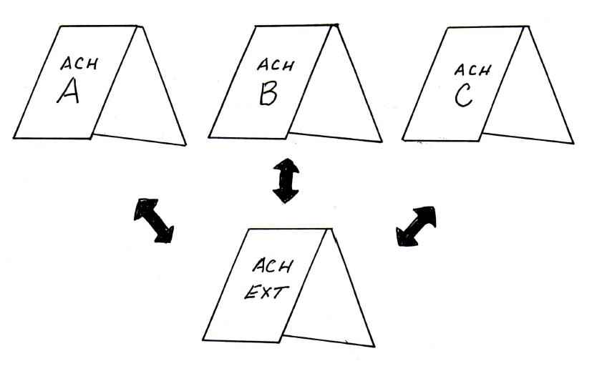
Organization
3 forms of the Standard Battery
1 form of the Extended Battery

Slide 85
Achievement
3 forms of the Standard Battery (Forms A, B, C)
  Tests 1–11
1 Extended Battery (use with all 3 forms)
  Tests 12–20
Core set of tests (1–6)
  Measures reading, writing, and mathematics achievement areas
  Creates the intra-achievement variation procedure
  Provides Brief Achievement cluster (Tests 1–3)

Slide 86
Achievement
20 tests
  11 in Standard Battery (3 forms)
  9 in Extended Battery (1 form)
22 clusters
  15 in Standard Battery
  7 additional when using Extended Battery

Slide 87
Achievement: What’s New?
7 new or extended tests
  Oral Reading, Reading Recall, Word Reading Fluency
  Number Matrices
  Science, Social Studies, Humanities
8 new clusters
  Reading, Reading Comprehension–Extended, Reading Fluency, Reading Rate
  Written Language
  Mathematics
  Brief Achievement, Broad Achievement

Slide 88
Achievement: What’s New?
Co-normed with WJ IV Tests of Cognitive Abilities and WJ IV Tests of Oral Language
Qualitative Observation checklists for Tests 1–11
  Located in Test Record
  Help document important information about how examinee performed on the task
  Include data on percentage of age mates at each rating

Slide 89
Achievement Standard Battery (Tests 1–11) (Forms A, B, C)
Core Tests (1–6)
Required for
intra-ACH variation
Creates:
Brief ACH
Reading
Mathematics
Written Language
Test 1: Letter-Word Identification
Test 2: Applied Problems
Test 3: Spelling
Test 4: Passage Comprehension
Test 5: Calculation
Test 6: Writing Samples
Test 7: Word Attack
Test 8: Oral Reading
Test 9: Sentence Reading Fluency
Test 10: Math Facts Fluency
Test 11: Sentence Writing Fluency
NEW!
Notes:
NOTE:
Only 1 new test: Test 8: Oral Reading
Moved from Extended battery : Test 7: Word Attack
3 Test Renamed:
Test 9. Sentence Reading Fluency (was Reading Fluency in WJ III)
Test 10. Math Facts Fluency (was Math Fluency in WJ III)
Test 11. Sentence Writing Fluency (Was Writing Fluency in WJ III)

Slide 90
Reading
Includes 8 tests measuring various aspects of reading
  Test 1: Letter-Word Identification
  Test 4: Passage Comprehension
  Test 7: Word Attack
  Test 8: Oral Reading
  Test 9: Sentence Reading Fluency
  Test 12: Reading Recall
  Test 15: Word Reading Fluency
  Test 17: Reading Vocabulary
NEW!
NEW!
NEW!

Slide 91
Reading
Provides 7 clusters for a comprehensive evaluation of reading performance
  Reading
  Broad Reading
  Basic Reading Skills
  Reading Comprehension (and Extended)
  Reading Fluency
  Reading Rate
NEW!
NEW!
NEW!

Slide 92
NEW!
Test 8: Oral Reading
A measure of oral reading skill that contributes to the Reading Fluency cluster
Select starting point based on examinee’s estimated achievement level.
Ceiling: Determined by cutoffs
Scoring 2, 1, or 0
  2 if sentence is read with no errors
  1 if sentence is read with one error
  0 if sentence is read with two or more errors

Slide 93
Test 8: Oral Reading
Types of reading errors that may occur:
Self-corrections within 3 seconds do not count as errors.

Slide 94
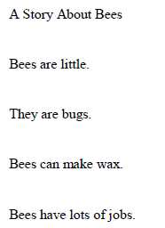
Test 8: Oral Reading
Mark each error on the Test Record with a slash (/) at the point in the sentence the error occurs.

Slide 95
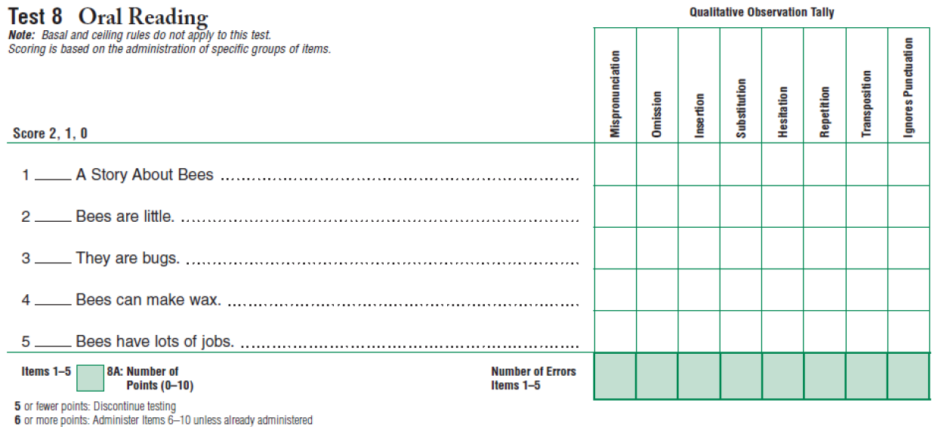
Test 8: Oral Reading
1
a boat
1
2
1
There
1
0
honey
1
1
1
1
5
2
1
1
1

Slide 96
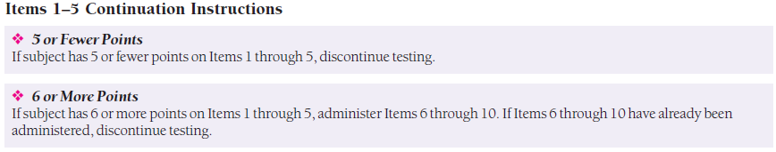
Test 8: Oral Reading
Follow Continuation Instructions to determine when to give additional items or when to discontinue testing.

Slide 97
NEW!
Test 12: Reading Recall
A measure of reading skill that contributes to the Reading Comprehension cluster
Select starting point based on examinee’s estimated achievement level.
Ceiling: Determined by cutoffs
Scoring 1 or 0 for each element
  1 if element is recalled correctly
  0 if element is not recalled or is recalled incorrectly

Slide 98
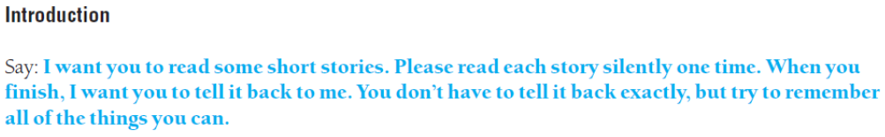
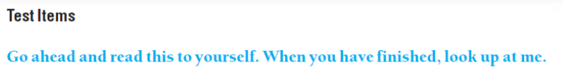
Test 12: Reading Recall

Slide 99
Test 12: Reading Recall
Turn the page after examinee has read the story one time.

Slide 100
Test 12: Reading Recall
Place a check mark over each element the examinee recalls correctly. Order does not matter.
/ Ann / lost her cat. / She looked under the car. / Then she saw it / in a tree. /
This story has 5 elements.
The bold words are the keys to receiving credit for the elements.

Slide 101

Test 12: Reading Recall
Example response:
Her cat was lost and she found it in a tree.
/ Ann / lost her cat. / She looked under the car. / Then she saw it / in a tree. /
Examinee earns 2 points for this response.

Slide 102
NEW!
Test 15: Word Reading Fluency
A measure of reading skill that contributes to the Reading Rate cluster
Administer sample items and practice exercise to all examinees.
Timed test: 3 minutes
Scoring 1 or 0 (use scoring guide overlay)
Do not tell the examinee any words on the test.

Slide 103
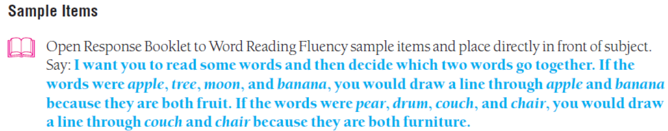
Test 15: Word Reading Fluency
Sample Items

Slide 104


Test 15: Word Reading Fluency
Practice Exercise
Follow Error and No Response directions carefully to ensure examinee understands task.
If examinee has 1 or 0 correct on Practice Exercise, discontinue testing and record a score of
0 for the test.

Slide 105
Test 15: Word Reading Fluency Scoring
Record exact finishing time in minutes and seconds.
  Early finishers who do well will receive a higher score than individuals who work for the full 3 minutes.
Count number correct.
Do not count skipped items.
Remind examinee to read silently, cross out instead of erasing, and to do all 3 pages.

Slide 106
Basic Reading Skills (Grw)
2-test cluster of basic reading skills, including decoding, sight vocabulary, phonics, structural analysis, and reading-writing (Grw) abilities
  Test 1: Letter-Word Identification
  Test 7: Word Attack
Median reliability: .95 (5–19) .96 (adult)

Slide 107
Reading Comprehension (Reading Comprehension–Extended)
2-test cluster of reading comprehension, reasoning, (Grw abilities), and to a lesser extent, long-term retrieval (Glr) ability
  Test 4: Passage Comprehension
  Test 12: Reading Recall
Median reliability: .93 (5–19) .93 (adult)
Reading Comprehension–Extended adds a third test, Test 17: Reading Vocabulary.
Median reliability: .96 (5–19) .94 (adult)

Slide 108
Reading Fluency (Grw, Gs)
2-test cluster measuring aspects of fluency, including prosody, automaticity, accuracy, reading-writing (Grw), and cognitive processing speed (Gs) abilities
  Test 8: Oral Reading
  Test 9: Sentence Reading Fluency
Median reliability: .96 (5–19) .96 (adult)

Slide 109
Reading Rate (Grw, Gs)
2-test cluster measuring automaticity with reading at the single word and sentence levels, reading-writing (Grw), and cognitive processing speed (Gs) abilities
  Test 9: Sentence Reading Fluency
  Test 15: Word Reading Fluency
Median reliability: .96 (5–19) .96 (adult)

Slide 110
Mathematics
Includes 4 tests measuring various aspects of math achievement
  Test 2: Applied Problems
  Test 5: Calculation
  Test 10: Math Facts Fluency
  Test 13: Number Matrices

Slide 111
Mathematics
Provides 4 clusters to evaluate performance in mathematics
  Mathematics
  Broad Mathematics
  Math Calculation Skills
  Math Problem Solving

Slide 112
Test 13: Number Matrices
A measure of math reasoning that contributes to the Math Problem Solving cluster
Select appropriate starting point.
Basal/Ceiling rules: (test by complete pages)
    6 lowest correct or Item 1
    6 highest incorrect or last item
Provide worksheet in Response Booklet and pencil when directed.
Number Matrices was in WJ III DS.

Slide 113
Test 13: Number Matrices
Sample A: Start here for K to Grade 8
To be correct, number must solve the puzzle vertically and horizontally.
Sample B: Start here for Grade 9 to Adult

Slide 114
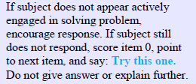
Test 13: Number Matrices
Monitor response time
Items 1–11 have a 30 second guideline.
Items 12 and higher have a 1-minute guideline.

Slide 115
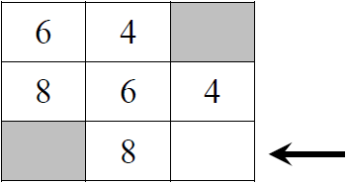
Test 13: Number Matrices

Slide 116
Test 13: Number Matrices
If examinee provides a response that is not a whole number, ask him or her to solve the problems using whole numbers only.
If examinee is confused by more than one matrix per page, you may uncover one at a time (use hand or paper to block).
A few matrices have more than one possible answer listed in the correct key. Only one correct answer is required to receive credit.

Slide 117
Math Calculation Skills (Gq, Gs)
2-test cluster of math achievement, including computational skills, automaticity with basic math facts, and cognitive processing speed (Gs) ability
Test 5: Calculation
Test 10: Math Facts Fluency
Median reliability: .96 (5–19) .97 (adult)

Slide 118
Math Problem Solving (Gq,Gf)
2-test cluster of math achievement and reasoning, including problem solving, analysis, and fluid reasoning (Gf) ability
Test 2: Applied Problems
Test 13: Number Matrices
Median reliability: .95 (5–19) .96 (adult)

Slide 119
Written Language
Includes 5 tests measuring various aspects of written language
  Test 3: Spelling
  Test 6: Writing Samples
  Test 11: Sentence Writing Fluency
  Test 14: Editing
  Test 16: Spelling of Sounds

Slide 120
Written Language
Provides 4 clusters to evaluate performance in written language
  Written Language
  Broad Written Language
  Basic Writing Skills
  Written Expression

Slide 121
Written Expression (Grw, Gs)
2-test cluster measuring meaningful written expression and fluency (reading-writing [Grw] abilities) and cognitive processing speed (Gs) ability
Test 6: Writing Samples
Test 11: Sentence Writing Fluency
Median reliability: .91 (5–19) .92 (adult)

Slide 122
Phoneme-Grapheme Knowledge
Includes 2 tests
  Test 7: Word Attack
  Test 16: Spelling of Sounds
Yields 1 cluster: Phoneme-Grapheme Knowledge
Requires both phonology and orthography
Provides insight into examinee’s knowledge of sounds and symbols
Median reliability: .93 (5–19) .94 (adult)

Slide 123
General Administration Points
Follow the standardized procedures for each test
Use the suggested starting points
Know the basal/ceiling rules for each test
Know the pronunciation of all items
Test by complete pages when items are visible on the examinee’s page
Score the last response given
Do not penalize for mispronunciations that are due to speech difficulties, regional, or dialect differences

Slide 124
Correct and Incorrect Keys
Use judgement on responses that aren’t listed
If can’t decide on two answers, score one as correct (1) and ones as incorrect (0)
On a few tests, the correct keys contain the only right responses (e.g. spelling, spelling of sounds)

Slide 125
Basal and Ceiling Rules
Provide guides for minimizing testing time
Reduce frustration
Allow estimates of the total score as if all of the items had been administered
Basal: the lowest set of consecutive correct specified or item 1
Celling: the highest set of consecutive incorrect responses specified or the last item
Noted in both the Test Book and Test Record

Slide 126
Complete Page Rule
Test by complete pages when stimulus items in the easel book are visible to the examinee
Complete the page even if it appears a ceiling has been reached
If the examinee gets and item correct in the process of completing the page, score the item “correct” and continue testing until a ceiling is reached, or the last item has been administered

Slide 127

QUESTIONS

Slide 128
Brenda de la Garza
Education Specialist
Special Education Program
School Improvement, Accountability and Compliance
Region One ESC
bdelagarza@esc1.net
(956)984-6202
(956)266-0250

